Slide 1
Internet Addresses

Slide 2
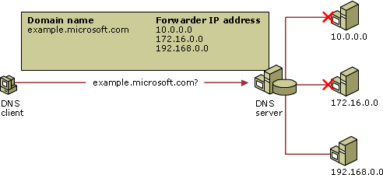
IP (Internet Protocol) addresses
Each computer on a network is assigned a unique set of four numbers from 0 to 255 each.
196.168.0.0 is an example of an IP address.
Private IP addresses are inside a company network.
A public IP address, like a web server, is a registered name that must be unique.

Slide 3
Domain Name Service (DNS)
Each registered domain name (for example www.abcnews.com) has a corresponding IP address.
DNS servers scattered throughout the world provide an index of names to numbers.
You can find the IP address for any internet name here https://who.is/dns/

Slide 4
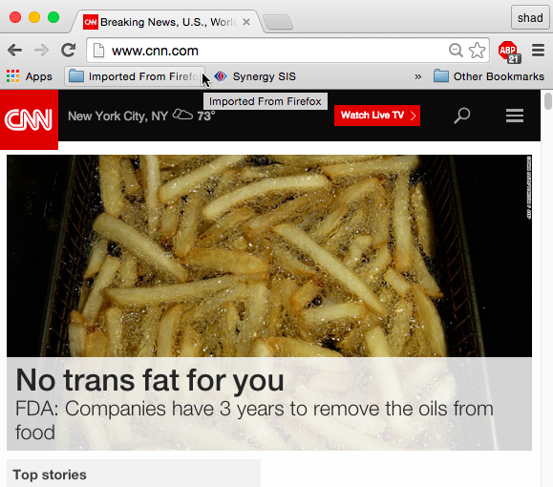
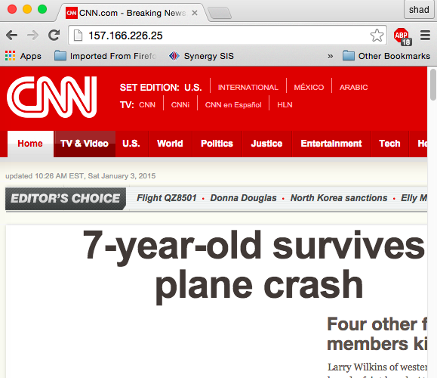
Domain name or IP address?

Slide 5

A URL…
Anatomy of a URL
protocol
host computer
directory path
file name
Note: Not all URLs will have the directory and filename

Slide 6
DNS Servers
Each request from a client is translated by a DNS server into an IP address.

Slide 7
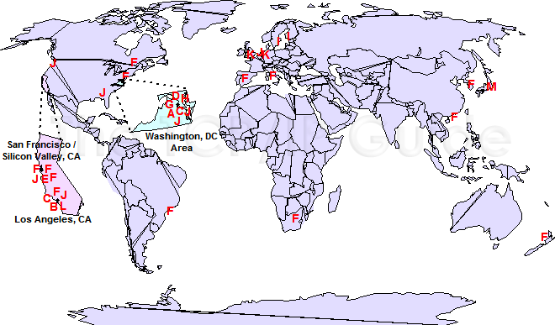
Where in the world are the root DNS servers?

Slide 8
Domain Affiliations
Domain | Affiliations
arts | cultural and entertainment activities
com | business organizations
edu | educational sites
firm | businesses and firms
gov | government sites
info | information service providers
mil | military sites
nom | individuals
net | networking organizations
org | organizations
rec | recreational activities
store | businesses offering goods for purchase
web | entities related to World Wide Web activities
net | networking organizations

Slide 9
Domain Lookup
Use https://who.is to find who the following IP addresses belong to.
68.180.131.16 _______________________________________
69.171.239.12 _______________________________________
136.8.33.21 ____________________________________

Slide 10
Domain Name Exercise
Go to www.godaddy.com
Check to see if you can register a domain name for you own name such as www.andewhopkins.com or www.joebrown.org
What would it cost to register for one year? ____________

